Slide 1
MEDC SMALL BUSINESS SERVICES & SOLUTIONS
February 28, 2023
Amy Rencher, SVP, Small Business Services
Natalie Chmiko, SVP, Small Business Solutions

Slide 2

MEDC IS COMMITTED TO ENABLING LONG-TERM UPWARD ECONOMIC MOBILITY FOR ALL MICHIGANDERS
GUIDING PRINCIPLES
STRATEGIC FOCUS AREAS
MISSION
Sustained, long-term growth Accelerate long-term job growth to address impacts of automation and protect Michigan’s economy against downturns.
Attract, retain, and grow business Attract, keep and grow businesses in industries that support maximum growth in jobs, wages and investments
Support and grow our talent Cultivate the skills and talent needed for in-demand and high-growth occupations statewide
Develop attractive places Collaborate with local communities and partners to create places in which people and talent want to live, work, visit and play
Achieve long-term economic prosperity for Michiganders by investing in communities, enabling the growth of good jobs and promoting Michigan’s strong image worldwide
Regional impact
Support every region – from rural areas to urban centers – to improve economic outcomes for all.
VISION
Make Michigan’s economy the nation’s fastest growing, most equitable and most resilient by:
Achieving ‘Top 10’ status for:
Job growth in targeted sectors
Equitable job growth
Real median household income growth
Attaining the largest net gain of talent in the Midwest
Becoming top ranked EDO
Equitable, high-wage growth
Provide equitable pathways toward high-wage growth that supports opportunities for all.
Accelerate high-tech innovation Support entrepreneurial growth to enable commercialization and new high-tech business creation
Market the state Promote Michigan’s image as a world-class business location and travel destination
Support small business Help existing small and microbusinesses grow and thrive and improve economic prosperity for all through small business ownership
Customer focus
Bring a customer-first, partner-driven mentality to all we do.
Notes:
AMY
SLIDE 2: MEDC SUPPORTS BUSINESSES AND COMMUNITIES STATEWIDE
The MEDC is Michigan’s lead advocate for business development, job awareness and community development, with the focus on growing Michigan’s economy and promoting Michigan’s reputation as a world-class business location and travel destination.
We set out to accomplish this mission by focusing our efforts around five strategic focus areas:
Attract, retain and support businesses
Foster high-wage skills growth
Develop attractive places
Catalyze entrepreneurship
Market the state
Our work ranges from supporting Michigan businesses and communities of all sizes by leveraging a comprehensive economic development toolkit to help them grow and succeed here in the state, while competitively pursuing business attraction opportunities to encourage companies around the globe to recognize the Pure Opportunity that Michigan can offer as a place to locate and do business.
We also work to strengthen and grow a thriving high tech startup ecosystem across the state.
Of course, this is all in addition to our work to market the state as a world-class business location and tourist destination through our Pure Michigan campaign and other business marketing programs and efforts.
As part of these efforts, we have identified a series of focus and regional impact industries – including advanced manufacturing, R&D and tech – that help guide the type of projects and opportunities that we support, however we are committed to working with businesses and communities of all shapes and sizes to find success here in Michigan.
Much of MEDC’s success in creating economic opportunities is the result of impactful partnerships with local economic development organizations; industry; academia; convention and visitors bureaus; and federal, state and local governments to foster economic development opportunities.
By maintaining a collaborative relationship with these partners, we are able to carry out our mission of enabling long-term economic prosperity for Michigan residents, businesses and communities throughout every corner of the state.

Slide 3


SMALL BUSINESS FUNDING OPPORTUNITIES
$236M SSBCI Capital (US Treasury)
$5.2M SSBCI Technical Assistance (US Treasury)
$75M Small Business SmartZones and Business Accelerators (SB7 sec. 304)
$135M Microenterprise/Main Street - proposed
Training & Support
Access to Capital
Systems & Technology
Navigating Resources
Ecosystem Building
Notes:
AMY

Slide 4
ROLE OF MEDC IN ECOSYSTEM
MEDC
EDOs & CDOs
CDFI’s, Banks & Credit Unions
DDAs, Small Town- Rural Municipalities & very small EDOs, CDOs
Professional Service Firms
Business Service Organizations &
Cultural-Ethnic Chambers of Commerce
SmartZones
&
Business Accelerators - Incubators
Resource Navigators
Trusted Connectors
Regional Prosperity Team
Service Center
Notes:
AMY
Resource Navigators – Help entrepreneurs navigate to and through MEDC and partner resources
Trusted Connectors – Drive on-the-ground insights to specific geographic and/or demographic, cultural groups. E.g. Small town/rural municipalities, DDAs, very small EDOs, CDOs, cultural/ethnic chambers of commerce, tribal entities, some business service organizations
Future could include:
Core Partners – Experienced Partners; Thought Leadership; Provide Statewide Perspective
Steering Committee – Ensuring connectivity to small business owners, cultural groups, industry, and geography-focused

Slide 5
SMALL BUSINESS STRATEGIC FOCUS INITIATIVES
Support Small Business Owners in Improving/Increasing:
Core business acumen (money, marketing, management)
Coaching and mentorship opportunities
Sales channels, new customers
Knowledge of systems and technology
Access to capital
Leverage and support Michigan’s entrepreneurial ecosystem to help businesses launch, stabilize and grow
Notes:
AMY
Improve core business acumen, increase 1on1 coaching, peer to peer, executive mentorship opportunities and industry roundtables
Diversify sales channels and attract new customers: export; e-comm; pitch prep; supplier readiness; connect to purchasers
Leverage systems and technology to support sustainability and growth: upskill/retrain to adopt new and evolving technologies; CRM; ERP; POS; omni channel (app development and AI, e.g.)
Increase access to capital: SSBCI; Capital Access; building pipeline from micro/CDFI to traditional banking relationships
Leverage and support Michigan’s entrepreneurial ecosystem to help businesses launch, stabilize and grow: Help navigate to and through
Sustainable, long-term growth: Improve business acumen; identify mentorship opportunities; prepare companies for financing; enable technology adoption; identify diversification opportunities & align stakeholders around the same mission
Regional impact: Leverage trusted connecters to ensure small businesses in every region are aware of resources to help them grow
Equitable, high-wage growth: Celebrate the strength and diversity of the ecosystem by ensuring equitable access to small business resources
Customer Focus: Ensure programming is responsive to the evolving needs of small businesses

Slide 6
MEDC SMALL BUSINESS SUPPORT RESOURCES
Starting a Business
Access to Capital
Training & Support
Connections & Procurement Opportunities
Leverage Technology
Notes:
AMY

Slide 7
Starting A Business
Michigan Small Business Development Center (SBDC)
SmartZones
Help startups, inventors, creatives and entrepreneurs accelerate their business concepts from idea stage to commercialization by providing them with the resources they need to grow, such as mentoring, business planning, market analysis and product development.
Offers consulting and training, business plan development, market research and more. SBDC can support companies in the idea stage or as an established business helping plan, launch, manage or grow business.
Notes:
AMY

Slide 8



ACCESS TO CAPITAL
SSBCI 1.0
SSBCI 2.0
CAPITAL ACCESS
LOAN PARTICIPATION
COLLATERAL SUPPORT
LOAN GUARANTEE
VENTURE CAPITAL
TECHNICAL ASSISTANCE
# of
Programs
CAPITAL ACCESS
LOAN PARTICIPATION
COLLATERAL SUPPORT
LOAN GUARANTEE
PRIMARILY
REGIONAL &
COMMUNITY
BANKS
REGIONAL & COMMUNITY BANKS
MINORITY DEPOSITORY INSTITUTIONS
CREDIT UNIONS
MICROLENDERS
CDFI’s
Participating
Lenders
MANUFACTURERS
SERVICE PROVIDERS
MAIN STREET
EARLY-STAGE TECH
MICROBUSINESSES
SEDI
Target
Customers
PREDOMINATELY
MANUFACTURERS
Notes:
AMY

Slide 9

TRAINING & SUPPORT
Main Street Business Support
Second-Stage Growth Solutions
Initiate: self-paced, multi-faceted online learning platform to support early-stage small businesses in improving finance, marketing and operations skills. Available in English and Spanish.
Optimize Main: helps small businesses located in eligible communities across the state use technology to create efficiency in business operations, improve connectivity to customers and increase sales.
Match on Main: provides funding for projects located in eligible communities that drive small business growth and contribute to vibrant commercial corridors.
provides second-stage companies and their leaders with a suite of services including technical assistance, retreats and roundtables to increase profits and fuel future growth.
Notes:
AMY

Slide 10
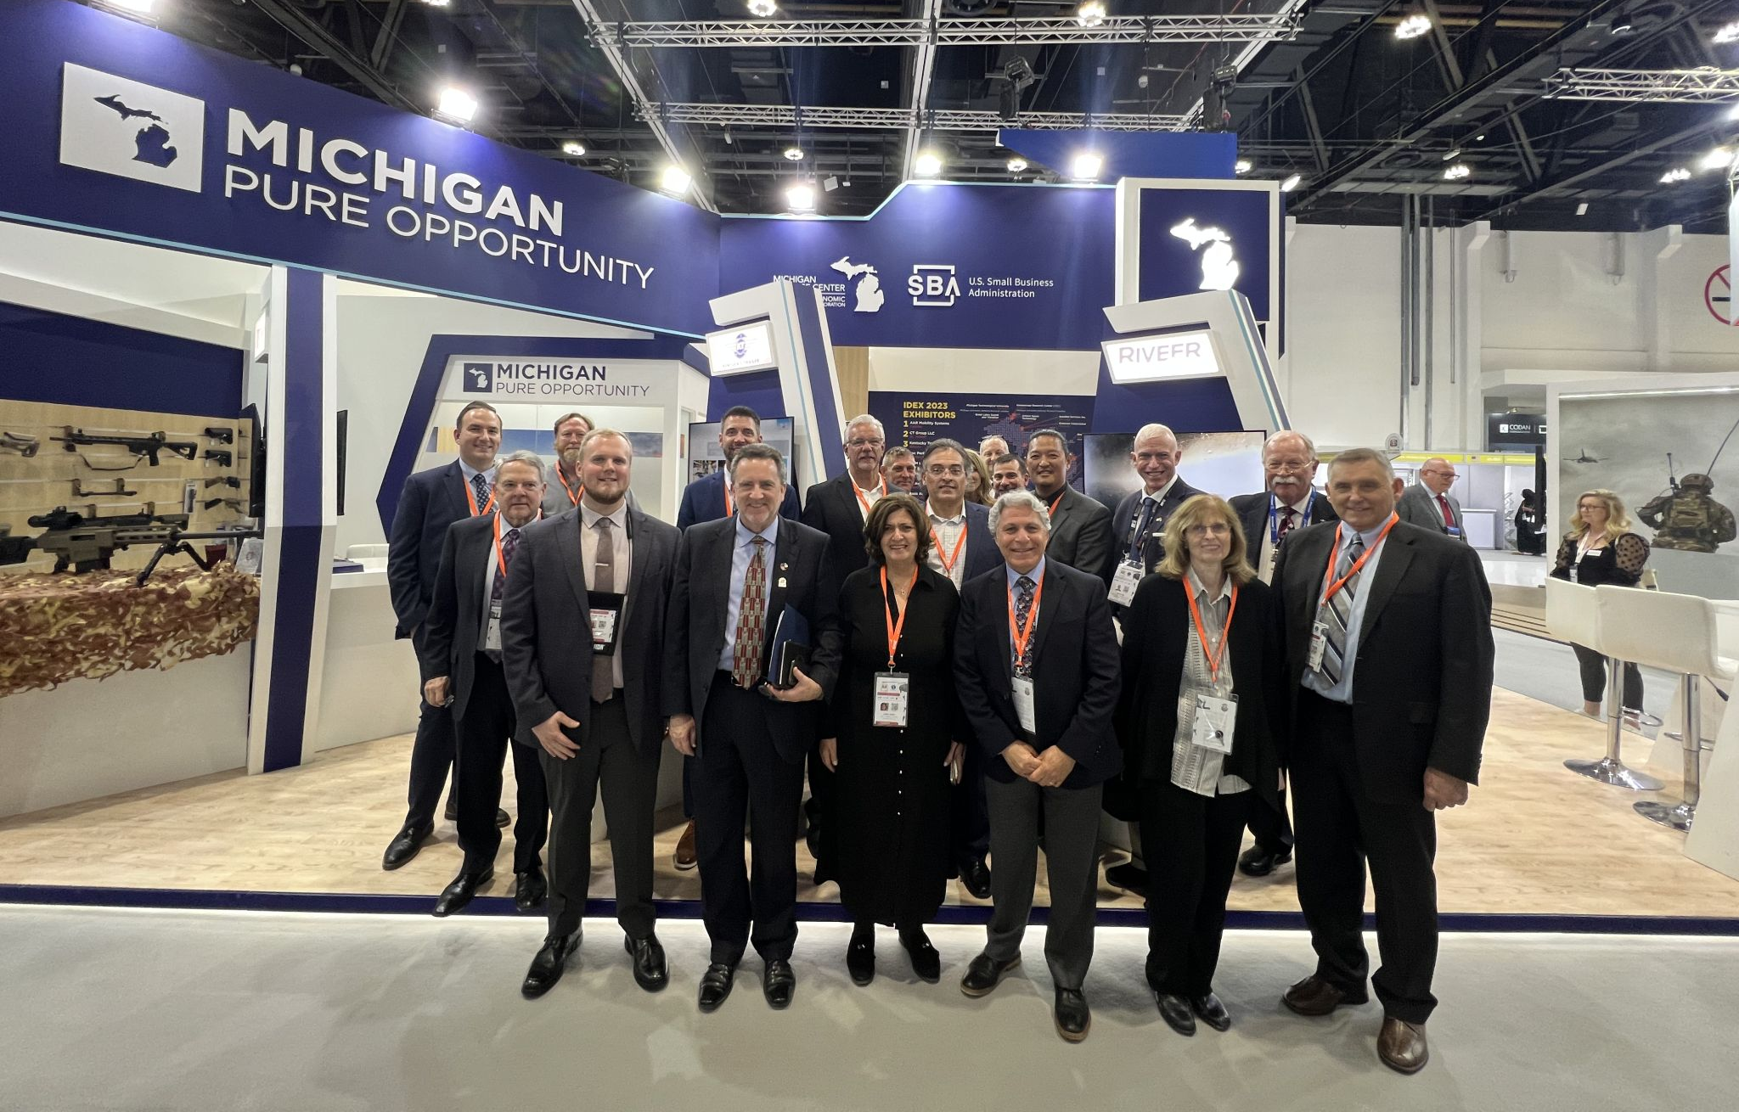
CONNECTIONS TO PROCUREMENT OPPORTUNITIES
International Trade Services
Pure Michigan Business Connect
The International Trade Program facilitates:
Trade Counseling
Export Education
International B2B Connections
Trade Missions & Shows
Financial Assistance for Export Development Activities
Connects Michigan suppliers of goods and services with local, domestic and global buyers based on demand and procurement needs through matchmaking initiatives. PMBC also helps localize or diversify a company’s supply base with custom research requests.
APEX Accelerators (formerly PTAC)
Support companies with securing, performing and retaining federal, state and local government contracts. Through seminars, events, training and consultations, PTAC works to help Michigan businesses succeed in the government marketplace.
Notes:
NATALIE

Slide 11
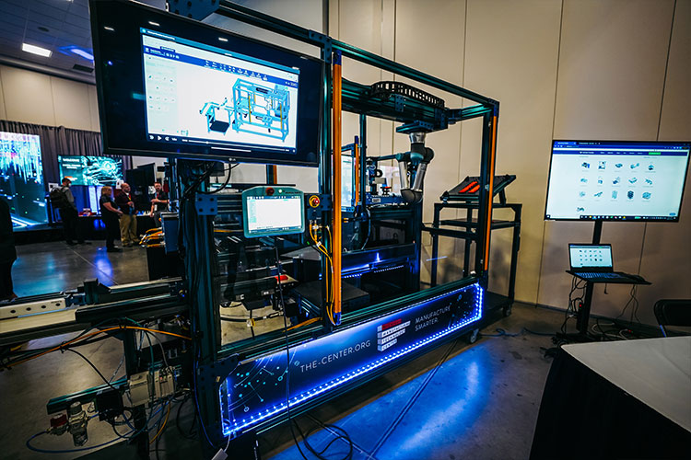
LEVERAGE TECHNOLOGY
Industry 4.0 Preparedness
The Industry 4.0 Signature Initiative is a statewide effort to support and encourage the adoption of Industry 4.0 technologies by Michigan’s small manufacturers. Through a network of partners, manufacturers can access events, education, technology assessments, implementation funding and more.
Notes:
NATALIE

Slide 12
michiganbusiness.org/smallbusiness
1.888.522.0103
Notes:
Mention resource finder?

