Slide 1




Where did all the
talent go?

Slide 2


Vision. Insights. Solutions.
Notes:
Images of people with sense of community (5 KPIs)

Slide 3


Our Impact
Investment in Quality PreK
Childcare
Early Literacy and Numeracy
K-12 Career Readiness
Quality Data and Research
Postsecondary Credentials
State ID for Returning Citizens
Coming Soon:
Michigan Center for Adult College Success
D&I Commitment
Labor Market Reports
Entrepreneurship
Notes:
Make this beautiful: keep all things
Need a headline for this slide: basic msg is demonstrating what TF activity

Slide 4
What is the Labor Force Participation Rate?
Employed + Unemployed
=
LFPR
Population (16+)
(Civilian, noninstitutional)
5.5% TRUE Unemployment Rate*
(Dec. 2022)
3.8% Unemployment Rate
(Dec. 2022)
*Counting those who dropped out of labor force.
Notes:
Official economic statistics suggest Michigan is finally nearing “full employment,” with the unemployment rate falling to 4.1% as recently as Sept 2022.
These numbers are encouraging, but the unemployment rate only considers those who are actively looking for work.
If we include the men and women who have dropped out of the labor force since the pandemic alone, Michigan’s unemployment rate would look more like 7.2% — representing a pool of 137,000 additional workers the state’s employers could draw from.
Who’s NOT Counted:
Incarcerated
Mental Institution
Adult Foster Care
Military
Benefits of Work
Mental, physical, and emotional wellness
Economic security
Market competitiveness (skill development)
Social connectedness
Focus on the equation more prominant

Slide 5
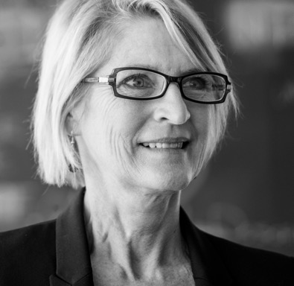
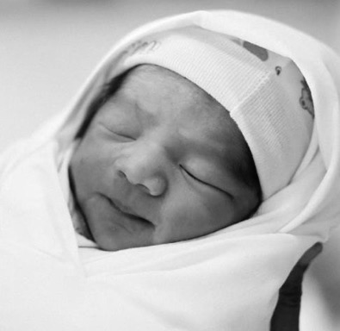
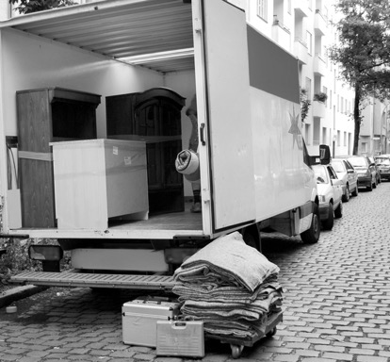
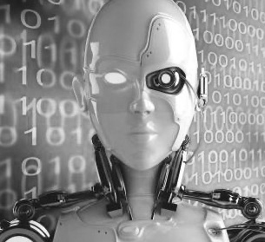
Why This is Critical for Michigan
Workforce is aging and retiring
Births not keeping pace
Negative net migration
Automation, AI, remote work demand new skills
Notes:
Less copy; more visual emphasis: either photo or icon
Kevin wants more imagery of ppl overall.

Slide 6
Jobseekers per Opening at Historic Low
Jobseekers per Job Opening, Michigan (2000-2022)
November 2001
30 jobseekers for every 10 openings
November 2022
7 jobseekers for every 10 openings
Job Openings and Labor Turnover Survey (JOLTS)
Notes:
Split into two slides: preceed with ppl and headline on one, then the graph

Slide 7
Decades of Decline: State’s Labor Force Participation
Labor Force Participation Rate (16+), Michigan (1976-2022)
-721,000 participants since Jan. 2000
Michigan
-97,200 participants since COVID
Local Area Unemployment Statistics (LAUS)
Notes:
ADD Population Growth

Slide 8



MICHIGAN
721,000
Fewer participants since
January 2000
Notes:
Better way to display this match the reports

Slide 9
Declining Participation in Every Age Group, Except 55+
Change in Labor Force Participation by Age Group, Michigan (2000 v. 2021)
-10.1%
-807,319
-4.1%
-152,414
-23.0%
-116,784
-9.2%
-57,070
-4.0%
-52,148
-4.2%
-49,648
-4.0%
-49,618
0.1%
1,330
4.1%
74,816
Current Population Survey (CPS), Subnational Estimates
Notes:
Highlight in order: 55+ > prime-age > 16-24
Slides 11-13 ok as is

Slide 10
Declining Participation in Every Age Group, Except 55+
Change in Labor Force Participation by Age Group, Michigan (2000 v. 2021)
-10.1%
-807,319
-4.1%
-152,414
-23.0%
-116,784
-9.2%
-57,070
-4.0%
-52,148
-4.2%
-49,648
-4.0%
-49,618
0.1%
1,330
4.1%
74,816
Current Population Survey (CPS), Subnational Estimates
Notes:
Highlight in order: 55+ > prime-age > 16-24

Slide 11
Declining Participation in Every Age Group, Except 55+
Change in Labor Force Participation by Age Group, Michigan (2000 v. 2021)
-10.1%
-807,319
-4.1%
-152,414
-23.0%
-116,784
-9.2%
-57,070
-4.0%
-52,148
-4.2%
-49,648
-4.0%
-49,618
0.1%
1,330
4.1%
74,816
Current Population Survey (CPS), Subnational Estimates
Notes:
Highlight in order: 55+ > prime-age > 16-24

Slide 12






Who Is On The Sidelines?
1 in 5 with Children
1 in 3 with Disability
1 in 2 Female
↑ 2% since 2000
↑ 20% since 2000
↑ 9% since 2000
1 in 10 with Substance Use Disorders
1 in 2 without Credential
1 in 7 Ages 16-24
↑ 5% since 2000
↑ 14% since 2003
↑ 20% since 2000
Current Population Survey (CPS), Subnational Estimates
Notes:
Highlight in order: 55+ > prime-age > 16-24
Slides 11-13 ok as is

Slide 13

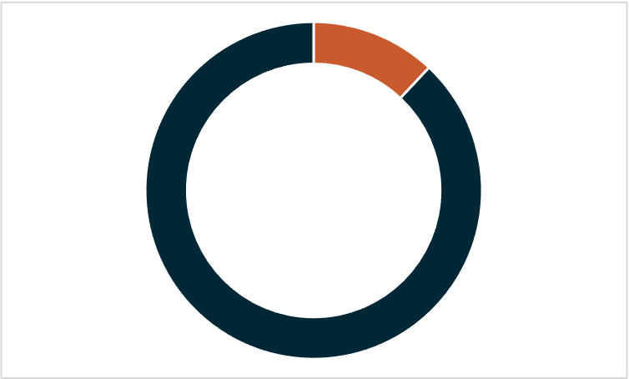
Skilled Workers Going Freelance
500,000+ Michigan
residents likely
full-time
freelancers
in 2020
12%
are full-time freelancers (no formal work)
Upwork, “Freelance Forward Economists Report,” 2021
53% of all freelancers are skilled
Notes:
This slide needs graphic help.
Replace 53% stat with a skilled worker or to signal to Kevin most are skilled workers. Don’t need the 53% stat.
Gig workers are not being accounted for in the LFPR – which means we’re are overestimating the attrition of the total number. This can become a pool for an employer.

Slide 14
Government Programs: Misaligned, Discourage Work, Create Poverty Traps
$3,006
$4,625
$3,076
$4,278
$2,752
$3,333 (Grand Rapids)

Slide 15
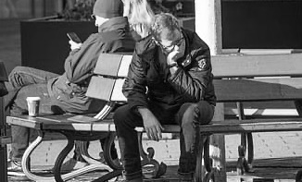
The Big Multiplier: Foundational Education
Adults in Michigan
710,000+
without
foundational
skills
14.3%
Unemployment
2x
More likely to be out of the workforce
1 in 4
in poverty
Notes:
Employers can:
Skills-based hiring, front-loaded tuition assistance, adult foundational education
Funding not important
Maybe not these stats, but there are skilled and not skilled.
Foreign-born workers in circles below the main text

Slide 16

The Big Multiplier: Upskilling
↑ 10%
earnings per additional year of schooling
2x
labor force participation with postsecondary credential
9 in 10
new high-wage jobs will require postsecondary training by 2030
↓ 50%
unemployment with each level of education
Notes:
Employers can:
Skills-based hiring, front-loaded tuition assistance, adult foundational education
Funding not important
Maybe not these stats, but there are skilled and not skilled.
Foreign-born workers in circles below the main text

Slide 17

The Big Multiplier: Education & Skills
1 in 10 workforce participants
Skilled Foreign-Born Workers
↓ 15.4% lower
employment
professional
occupations
↑ 11% higher
participation
rate than
native-born
61%
education beyond high school
Notes:
Employers can:
Skills-based hiring, front-loaded tuition assistance, adult foundational education
Funding not important
Maybe not these stats, but there are skilled and not skilled.
Foreign-born workers in circles below the main text

Slide 18
Employers Can Make a Big Difference
Substance Use
Formerly Incarcerated
Child Care
Disabilities
2x
lower turnover rate
44%
of decline in prime-age male participation due to opioids
2-3 million
Michiganders with a criminal history
1 in 5
out of workforce with children under 18
2x
poverty rate per additional child
40%
labor force participation rate
700,000
likely still employed with a substance use disorder
13%
lower turnover rate
$8,817
average annual cost per employee with an untreated SUD
540,000+
out of workforce
130,000+
single parents
out of workforce
478,000
married parents
out of workforce
950,000+
out of workforce
Notes:
4 panels – build out facts
2nd slide – Education and Skills (skills-based hiring, adult education, credentialing issue)
Add icons maybe

Slide 19
Growing the Workforce
Pull
Push
(Employers)
(Policymakers)
Expand and align programs to reward work and promote economic mobility.
Remove barriers and invest in workers.
Flexibility. Wraparound Supports.
Accommodations. Upskilling.
Second-Chance Hiring.
TANF. SNAP. Occupational Licensing.
EITC. Unemployment Insurance.
Child Support. Medicaid.
Disability Insurance.
Notes:
Key is showing they are separate but overlapping in
PULL: add Employer Policy
PUSH: Policymakers

Slide 20


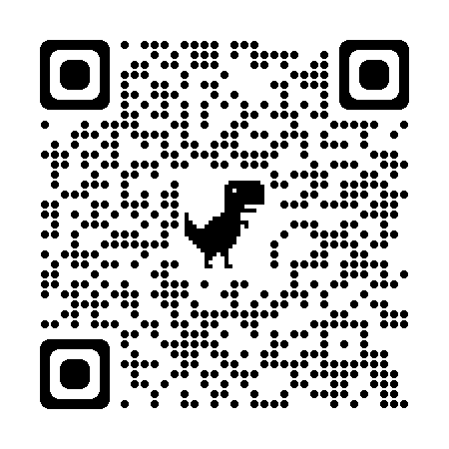
Employer Talent Solutions
Establish Talent
Pipelines
Embrace
Automation & AI
Invest in Upskilling
Your Workforce
Employer Brand
is Everything
Hire for Attitude,
Train for Skills
SCAN ME
Notes:
Images of people with sense of community (5 KPIs)

Slide 21

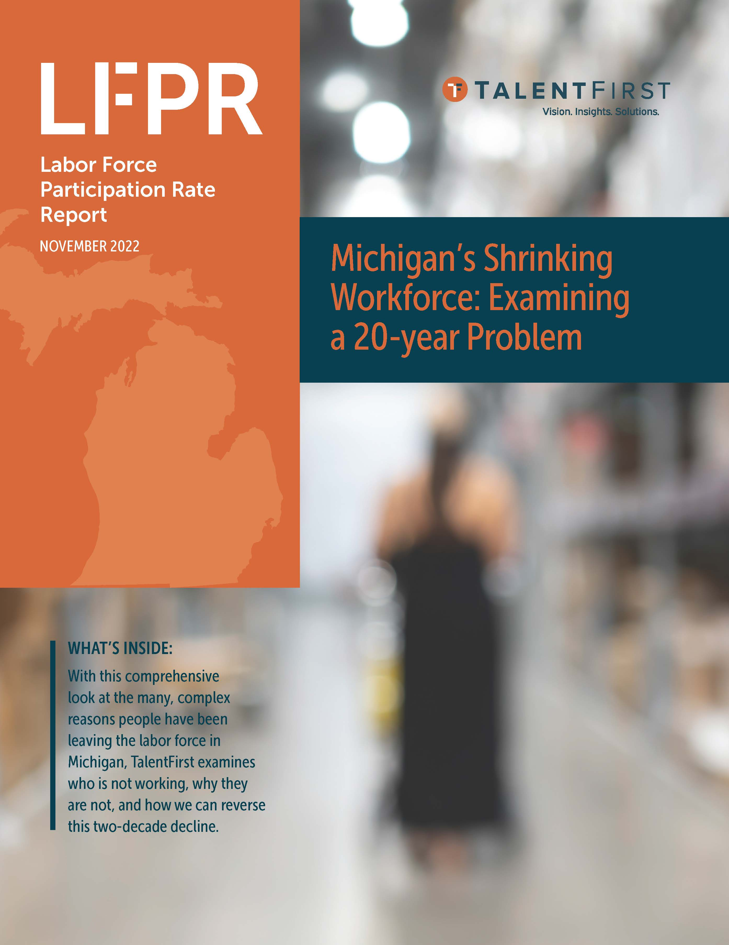
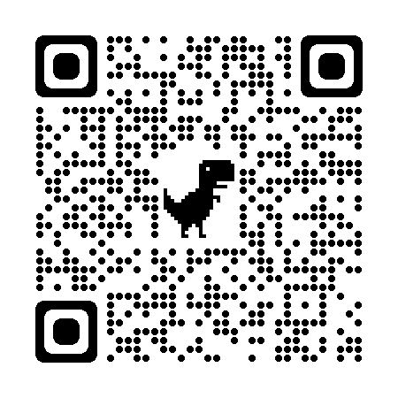
Policy Solutions…
Now. Next. Later.
SCAN ME
Notes:
Images of people with sense of community (5 KPIs)

Slide 22
Restoring Labor Force Participation: What’s Possible
Michigan
+720,000 participants
+$22.1B in economic activity
(earning median income of $30,723)
+$941M in tax revenues
14% fewer in poverty
2x current job openings
Notes:
IF LFPR returned to 2000:
Key point is number of participants, financials #2 and 3 then the other two job openings and poverty

