Slide 1
SMART Marketing On a Budget

Slide 2
Hi, nice to meet you!
Notes:
My name is Ayesha Qureshi. I’m the founder of Q Line Media. We’re a detroit based marketing agency that serves small and medium businesses. We pride ourselves on personalized service and a very hands on approach with the owners we work with.
Fun facts:
I have two kids who I love to travel with.
I drink a lot of coffee.
I don’t mean to brag, but earlier this week I read to my daughter’s kindergarten class and the kids clapped, so hopefully this content gets you just as excited as the Creepy Carrots book that I read to a bunch of kindergarteners (which I highly recommend if you’ve got young kids).

Slide 3
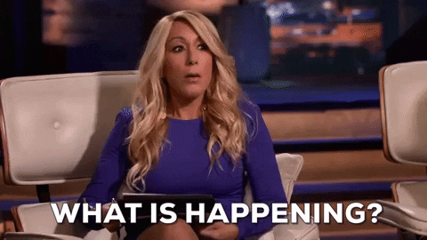
What are we talking about today?
Today is all about you and your business. It’s about planning, vision, and progress. It’s about shifting from reactive to proactive marketing initiatives.
Notes:
So we’re gonna talk all things marketing and marketing strategy. Marketing strategy is one of those things business owners know they need, but it tends to fall to the wayside in the hustle and bustle of the day to end. More often than not, I see business owners marketing in a reactive way as opposed to proactive. Thing about it. How many of you have heard of a new social platform or trend that you’ve suddenly felt the pressure to have to jump on, only to do it half way because you have a million other things on your plate.
A strategy will save you from having to be so reactive (although reactive marketing isn’t always bad) and give you a path forward to creating a strategy that works over time.

Slide 4
The Power of Vision
Notes:
Vision is the glue that binds all business owners and entrepreneurs. We all have different backgrounds and experiences AND we all have a unique energy and excitement that gets us out of bed in the morning: that’s our vision. Whether you’re just brainstorming ideas or have a business that you’re looking to grow, you have a vision.
If you’re like most business owners, you’re likely thinking about business or your next ideas a lot of the time. We made a rule in our home no business talk after 6pm. Sometimes we break it, but it’s one of the ways we keep a work life balance.
You probably lay in bed and think about your business, or the next idea, or how to spread the word about your business. Your mind might flit to what to make for dinner or that that leaky faucet needs to be fixed, but business is always on your mind and it takes a lot of practice to strike a healthy balance between the two.

Slide 5
63%
Of Small Business Owners Don’t Have a Marketing Strategy
Source: https://www.marketingevolution.com/knowledge-center/50plus-data-driven-marketing-and-personalization-stats-marketers-need-to-know
Notes:
What if I told you, though, that as visionary as us entrepreneurs are, we often lack a marketing strategy. Interestingly, the marketing strategy (which can also be looked at as a vision) is an important part of making your vision for your business come to life. Without a plan, it feels like you’re throwing spaghetti at the wall and trying to make it stick. Or you’re spraying and praying and hoping that the right people hear your message.

Slide 6
My Goal Is To Ensure You Don’t Become a Part of This Statistic
Notes:
I want you equipped to bring your vision for your business to life. I want you to succeed. There’s room for everyone to do well. I literally cheerlead for my clients. I always wanted to be a cheerleader in high school, but I wasn’t allowed, so now I do it for clients.

Slide 7
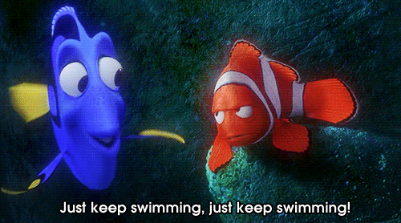
What should you get out of this?
Learn the framework of creating budget marketing tactics
Understand marketing doesn’t have to take Barbie or Oppenheim dollars to be successful
Walk away motivated to start marketing your business with a plan
Make “just keep swimming” your mantra.
Notes:
I want you to walk away with less fear when it comes to marketing. I’m sure you’ve seen memes floating around LInkedIn talking about barbie and oppenheim marketing costs. Nevermind that $150 million on marketing isn't that crazy, and most of the brands that collaborated actually paid the company to participate.

Slide 8
Setting Goals
Notes:
Setting goals is the best way to eventually determine if your marketing is working. So we start with goals and build out our strategy from the goals we want to achieve.

Slide 9
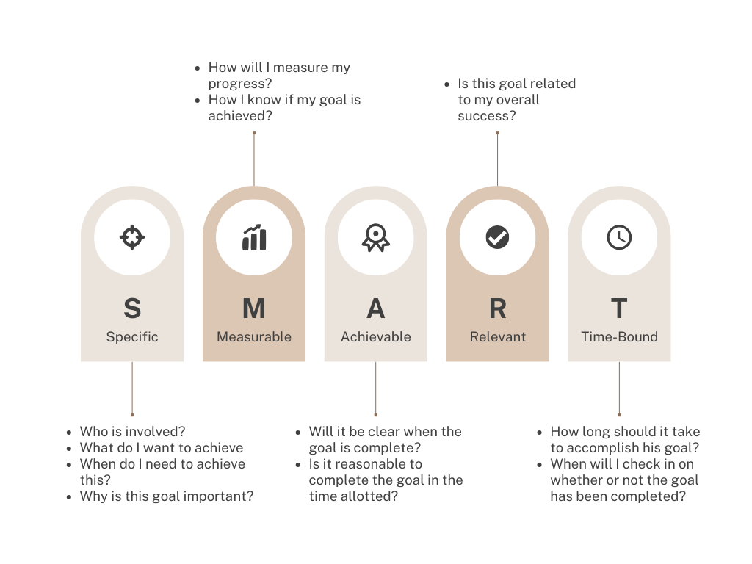
Setting SMART Goals
Notes:
S - Specific: Your goals should be well-defined and specific, leaving no room for ambiguity. The
clearer your goal, the easier it is to work towards it.
M - Measurable: Effective goals should be quantifiable. You need to be able to track progress and measure success. Ask yourself: How will I know when I've achieved this goal?
A - Achievable: While ambitious goals are great, they should also be attainable. Ensure that your goals are realistic given your resources, capabilities, and constraints.
R - Relevant: Your goals should align with your business's mission, vision, and overall strategy. They should be relevant to your long-term success.
T - Time-bound: Setting a deadline for your goals creates a sense of urgency and accountability. When will you achieve this goal? What's the timeframe?

Slide 10
SMART Goal
Not SMART Goal
Grow email subscription list 30% by the end of Q4 using social media to drive people to the sign up form.
Get more email subscribers.

Slide 11
Why are SMART goals important?
Roadmap To Success
Notes:
These are a roadmap to success. They play a major role in helping you understand if you’re making progress making objectives clear, measurable, attainable, relevant, time-bound, and motivating. They enhance your ability to plan, execute, and achieve results.

Slide 12
Knowing Your Target Audience
Notes:
We hear about target audiences all the time. The term is thrown around willy nilly and made to sound basic, but there’s more to it than that. But don’t let that scare you. It’s also not that complicated.

Slide 13
Your target audience can’t be everyone.
Notes:
Your target audience cannot be everyone. And it can’t be demographics. So things like age or gender. Because a 25 year old single mom in Detroit has a very different life from a 25 year old stay at home mom in Detroit. They might have age, motherhood, and geography in common, but their pain points are likely to be very different.

Slide 14
Creating a Target Audience Persona
1. Demographics:
Who are they? (Age, gender, location, income, etc.)
2. Psychographics:
What are their interests, values, and lifestyles?
3. Pain Points and Challenges:
What problems are they trying to solve? What challenges do they face?
4. Buying Behavior:
How do they make purchasing decisions? What influences them?
5. Communication Preferences:
Where and how do they prefer to receive information?

Slide 15
Example Target Audience Persona
Let's say you're selling organic skincare products. Your target audience might include:
Demographics: Women aged 25-45, urban and suburban areas.
Psychographics: Health-conscious, environmentally aware, and seeking natural beauty solutions.
Pain Points: Concerns about skin health, desire for eco-friendly products, seeking anti-aging solutions for fine lines and wrinkles.
Buying Behavior: Research-driven, influenced by online reviews and recommendations.
Communication Preferences: Active on social media, email subscribers.

Slide 16
But WHYYY?
Tailored Marketing: Craft messages and campaigns that resonate with your audience.
Cost-Effective: Allocate your marketing budget more efficiently.
Build Relationships: Create trust and loyalty by addressing their specific needs.
Competitive Advantage: Stay ahead by delivering what competitors can't.
Notes:
This kind of work is the unsexy part of marketing. It’s kind of boring and no one is actually going to see it, but it’s important to make sure you’re steering yourself on the right track and even innovating. The more you know your people the more you can anticipate and meet their needs.

Slide 17
Branding and Identity

Slide 18
What is branding?
Notes:
Before we dive into what branding is, let’s talk about what it isn’t. It isn’t a logo. It isn’t a font. It’s isn’t colors. When you think about branding, I want you to think bigger.

Slide 19
Branding is more than just a logo or a catchy slogan; it's the heart and soul of your business. It plays a fundamental role in shaping your marketing strategy and how your audience perceives your brand.
Notes:
When you think of your branding, think about how you’re consistently showing and telling people how to think about you. Are you using certain tones? What do you colors say and are they used consistently?

Slide 20
Branding is the practice of creating a distinctive and recognizable identity. It encompasses visual elements like logos and colors, as well as messaging and the overall perception a brand evokes in the minds of its audience.
Notes:
Branding aims to differentiate a brand from competitors and build a strong, consistent image that resonates with consumers.

Slide 21
What components contribute to branding?

Slide 22
1. Identity and Differentiation: Your brand defines who you are and what sets you apart from competitors. It creates a unique identity that helps customers recognize and remember you.
2. Trust and Credibility: A strong brand builds trust with your audience. It reassures customers that you're reliable and that you deliver on your promises.
3. Emotional Connection: Effective branding evokes emotions and resonates with your audience on a personal level. It creates a sense of belonging and loyalty.
4. Consistency: Branding ensures consistency in messaging and visuals across all marketing channels. This consistency reinforces your brand identity.
5. Value and Pricing: A strong brand allows you to command higher prices for your products or services. Customers are often willing to pay more for a trusted brand.
6. Recognition and Recall: Memorable branding leads to recognition and recall. Customers are more likely to choose a brand they remember.

Slide 23
Benefits of Branding
Customer Loyalty: Build a loyal customer base that sticks with you.
Competitive Advantage: Stand out in a crowded marketplace.
Brand Equity: Increase the perceived value of your brand.
Growth: Attract new customers and expand your reach.
Notes:
Branding is an investment that yields long-term growth that comes from it.

Slide 24
The Power of Storytelling

Slide 25
Stories Are Connective
Emotional Connection: Stories have a unique ability to forge emotional connections with your audience.

Slide 26
Stories Are Relatable
Relatability: Stories make your brand relatable. People relate to characters, conflicts, and resolutions.

Slide 27
Stories Are Memorable
Memorability: Facts and figures may fade, but stories stick. Studies show people remember stories more than data.

Slide 28
22X
The number of time people are more likely to remember stories more than facts and statistics.

Slide 29
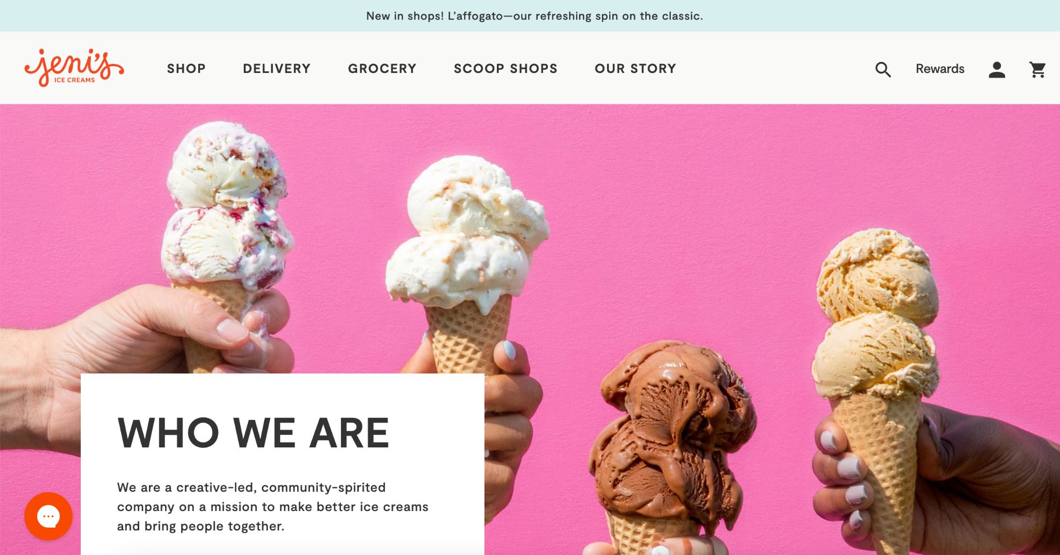
Jeni’s Splendid Ice Cream
Background:
Jeni's Splendid Ice Creams is a small artisanal ice cream company based in Ohio, known for its unique and high-quality ice cream flavors.

Slide 30
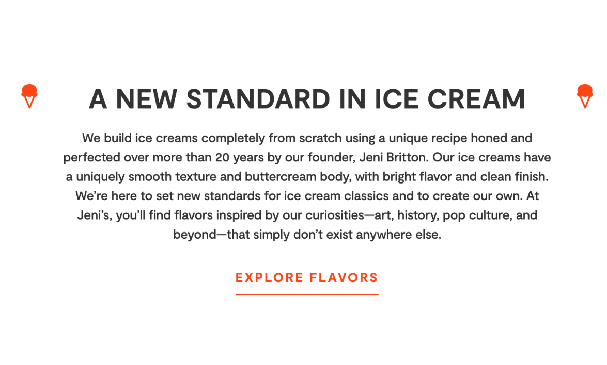
Jeni’s Splendid Ice Cream
Storytelling Elements:
Founder's Journey: The brand's founder, Jeni Britton Bauer, often shares her personal journey of starting the company from scratch and her passion for creating unique ice cream flavors.
Ingredients Story: Jeni's emphasizes the use of high-quality, locally sourced ingredients. They tell the story of partnering with local farmers and producers, fostering a sense of community and authenticity.
Flavor Stories: Each ice cream flavor has a story behind it. Whether it's the inspiration from a childhood memory or a local ingredient, these stories make each flavor special.

Slide 31
Content
Notes:
Phew! There’s a lot to say about content. In fact, this could be a session in and of itself. If there’s one thing I want you to take away from this section, it’s that you need to do some sort of content marketing. Test types of content, see what does well and what type of content your audience prefers, then keep doing and ditch what doesn’t work.

Slide 32
Content is the cornerstone of successful marketing strategies. It's the art of creating valuable, relevant, and engaging material that attracts and retains your target audience.
Notes:
If there’s one thing you focus on among all marketing strategies, it’s content. Here’s the thing about content: it’s something everyone knows they should be doing, but few do because it take a ton of time.
You know how they say showing up put you ahead of most people. That’s the case here.

Slide 33
Simple Content Marketing Formula
Knowing Your Audience’s Problem +
Your Uniqueness ✕ Your Formats ÷ Your Platforms

Slide 34
Content Types | Blogging
Tip: Consistency is key—regular blog posts keep your audience engaged and keep feeding the content machine.
Building Authority: Blogging allows you to establish yourself as an industry expert.
Engaging Content: Share valuable insights, tips, and knowledge relevant to your audience.
SEO Benefits: Blogging improves your website's visibility on search engines.
Websites with blogs receive 55% more organic traffic.

Slide 35
Content Types | Video
YouTube for Visibility: YouTube is the second largest search engine globally; it's an ideal platform for video content.
Instagram's Visual Appeal: Instagram's visual nature is perfect for showcasing products, services, and brand personality.
Use Instagram Stories and Reels for varied video content.
Less picture and more video oriented now
Engagement and Connection: Video content allows you to connect on a more personal level with your audience.
Video content on social media gets 1200% more shares than text and images combined.

Slide 36
Repurposing Content
Efficiency: Repurposing content saves time and effort. Turn a blog post into various formats.
A single blog post can become a podcast episode, infographic, video, and social media posts.
Longform videos can be cut into smaller, snackable pieces to be shared on platforms like TikTok and Instagram Reels.
Audience Preferences: Different audience segments prefer different content types. Cater to their preferences.
Tip: Conduct surveys or analyze data to identify preferences.
Extended Lifespan: Repurposed content breathes new life into older material, reaching new and existing audiences.

Slide 37
75%
Increase in content lifespan through repurposing.

Slide 38
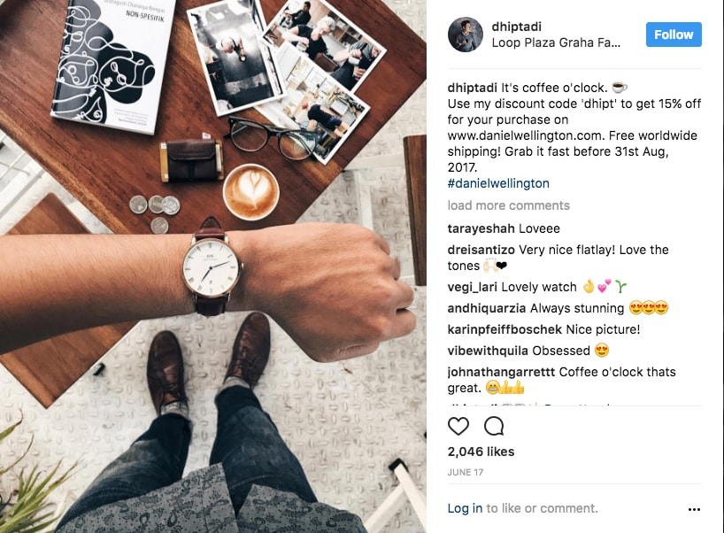
User Generated Content
What Is UGC?: User-generated content is content created by your customers or community.
Trust and Authenticity: UGC builds trust as it's perceived as genuine and unbiased.
Cost-Effective Marketing: UGC is free or low-cost, reducing the need for expensive ad campaigns.
Brands that incorporate UGC see a 29% increase in web conversions.

Slide 39
UGC Creation Ideas
Contests and Giveaways: Organize contests where participants can submit content related to your products or services. Offer prizes or discounts to winners. For example, a photo contest where customers share pictures of themselves using your product.
Hashtag Campaigns: Create a unique and memorable hashtag related to your brand or campaign. Encourage customers to use it when posting about their experiences with your products or services. Feature the best posts on your own social media profiles.
Product Reviews: Ask customers to leave reviews and ratings on your website or review platforms like Google, Yelp, or Trustpilot. Highlight the most positive reviews on your website. Put a plan in place to respond to negative reviews.

Slide 40
UGC Creation Ideas
Testimonials: Request written or video testimonials from satisfied customers. These can be displayed prominently on your website or in marketing materials.
Customer Stories: Invite customers to share their personal stories or experiences with your brand. Publish these stories on your blog or social media, giving credit to the customers who shared them.
Influencer Collaborations: Partner with influencers in your niche who can create content featuring your products. Their content can be a valuable form of UGC.
Ask for Feedback: Encourage customers to provide feedback or suggestions for improvement. When they see their input leads to changes or enhancements, they'll feel valued and engaged.
Share User Success Stories: If your product or service has helped customers achieve success, ask them if you can share their story. This can be particularly powerful in B2B contexts.

Slide 41
Marketing Channels

Slide 42
8
The number of times an ad or message needs to be seen before sinking in.
Source: https://www.indoormedia.com/blog/how-many-times-do-customers-have-to-see-an-ad#:~:text=day%20at%20that.-,Repetition,it'll%20really%20sink%20in.
Notes:
But we know that a person sees anywhere from 4,000-10,000 ads per day. This means that your message is really hard to get through.

Slide 43
How do we get the message across?

Slide 44
Omnichannel marketing is a strategy that unifies all marketing channels and platforms to provide customers with a consistent and personalized experience.
Notes:
It recognizes that customers may start their journey on one channel and switch to another before making a purchase.

Slide 45
Channels and Platforms
Social Media
Email Marketing
Content Marketing
Search Engine Marketing
Pay-Per-Click (PPC)
Video Marketing
Social Media Advertising
Affiliate Marketing
Notes:
Social Media: Utilize platforms like Facebook, X, Instagram, and LinkedIn to connect with your audience.
Fact: email marketing has the highest ROI. Email Marketing: Send targeted messages directly to subscribers.
Content Marketing: Create valuable content on your website and blog.
Search Engine Marketing: Use SEO and paid advertising to appear in search results.
Pay-Per-Click (PPC): Run paid ads on search engines and other platforms.
Video Marketing: Engage your audience with video content on platforms like YouTube.
Social Media Advertising: Promote your products or services through paid ads on social networks.
Affiliate Marketing: Partner with affiliates to promote your products or services.

Slide 46
Email Marketing
Why Email Marketing Matters
Email marketing remains one of the most cost-effective and powerful digital marketing channels.
Email marketing generates an average ROI of $42 for every $1 spent.
Building Your Email List
Forms
Incentives
Integral part of opting in
Segmentation and Personalization
Segmenting your email list based on demographics, behavior, or interests can improve engagement.
Use personalization to customize subject lines and content

Slide 47
Email Marketing
Creating Compelling Email Content
Tips for crafting engaging email content, including clear and concise messaging, compelling visuals, and a clear call to action (CTA).
Automating Campaigns
Welcome series
Abandoned cart
Abandoned check out
Tracking and Analytics
Discuss the importance of tracking email metrics like open rates, click-through rates, and conversion rates.
Through these analytics you’ll understand the type of content that resonates with your audience, when they’re engaging, and be able to continually improve.
Notes:
Ecommerce businesses these are some integral campaigns that you should have set up

Slide 48
Email Marketing
Avoiding Spam and Deliverability Issues
The most important part of avoid getting blacklisted is to ensure people are opting in. This means they’re asking to hear from you by filling out a form or consenting to email marketing.
DMARC, DKIM, SPF
Free tool to check if this is configured correctly
https://redsift.com/tools/investigate
Notes:
A blacklist is a collection of IP addresses that are believed to distribute spam; emails from these addresses are either blocked or routed to the recipient's spam folder. Blacklists are identified by spam filters, which use set criteria to identify emails believed to be of a malicious or spammy nature.

Slide 49
Email Marketing
1. DKIM (DomainKeys Identified Mail):
Imagine you're sending a physical letter. DKIM is like putting your unique signature on the envelope.
It's a way for email providers to make sure that the email you receive is really from the sender it claims to be from.
DKIM adds a digital signature to emails, making them harder to fake or tamper with.
2. DMARC (Domain-based Message Authentication, Reporting, and Conformance):
Think of DMARC as the traffic cop for your emails.
It helps email senders (like businesses) and receivers (like email providers) work together to ensure emails are genuine.
DMARC tells email providers what to do with emails that don't pass DKIM or SPF checks, like sending them to the spam folder or rejecting them.
3. SPF (Sender Policy Framework):
SPF is like a guest list for your email party.
It helps email receivers check if an email is invited or just a crasher.
SPF specifies which email servers are allowed to send emails on behalf of your domain. If an email comes from an uninvited server, it might be marked as suspicious.

Slide 50
Metrics and Analytics

Slide 51
Marketing Doesn’t Stop at Execution
Marketing involves continuous measurement and analysis to track your progress, make data-driven decisions, and optimize your strategies.
Notes:
Remember the SMART goals we talked about earlier? Metrics are going to be how you determine if you have met them.

Slide 52
Metrics to Track
1. Website Traffic
2. Conversion Rate
3. Return on Investment (ROI)
4. Click-Through Rate (CTR)
5. Customer Acquisition Cost (CAC)
6. Customer Lifetime Value (CLV)
7. Social Media Engagement
8. Email Metrics
9. Bounce Rate
10. Churn Rate
Notes:
1. Website Traffic:
Monitor the number of visitors, page views, and user behavior on your website. Use tools like Google Analytics.
2. Conversion Rate:
Calculate the percentage of visitors who take a desired action, such as making a purchase or filling out a contact form.
3. Return on Investment (ROI):
Measure the return on your marketing investment by comparing the cost of your campaigns to the revenue generated.
4. Click-Through Rate (CTR):
Track the percentage of people who clicked on your ads or email links, indicating engagement.
5. Customer Acquisition Cost (CAC):
Determine how much it costs to acquire a new customer through your marketing efforts.
6. Customer Lifetime Value (CLV):
Estimate the total revenue a customer is expected to generate over their entire relationship with your business.
7. Social Media Engagement:
Monitor likes, comments, shares, and follower growth on social media platforms.
8. Email Metrics:
Track email open rates, click-through rates, unsubscribe rates, and conversion rates from email campaigns.
9. Bounce Rate:
Measure the percentage of visitors who leave your website after viewing only one page.
10. Churn Rate:
Calculate the rate at which customers stop using your product or service.

Slide 53
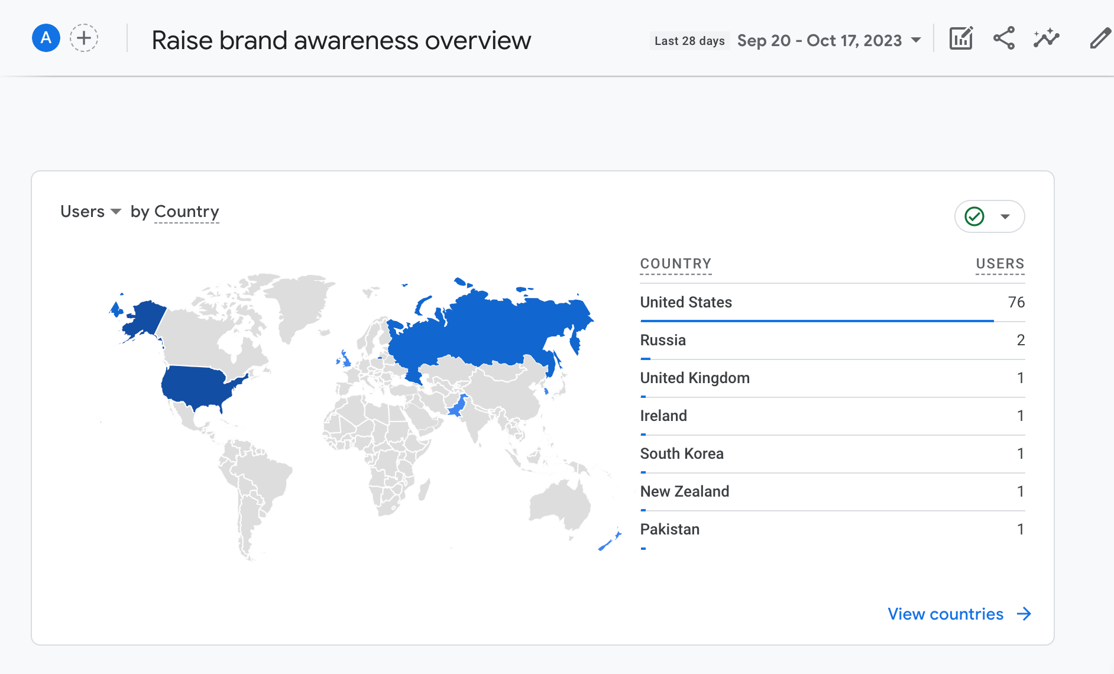

Slide 54
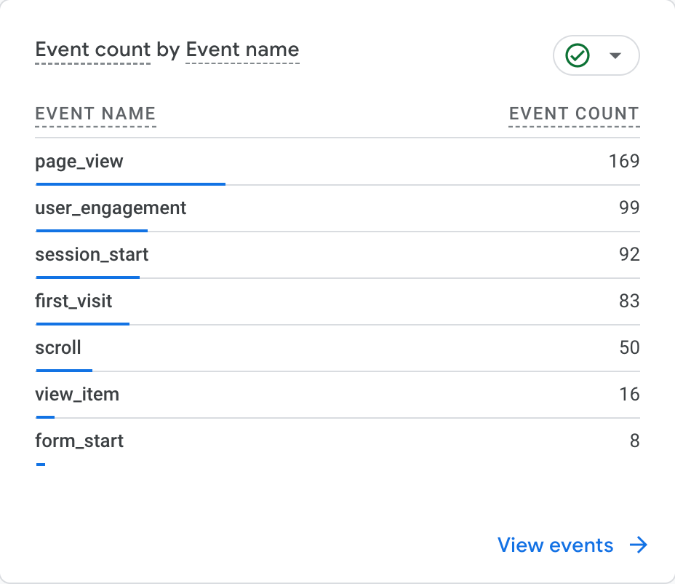

Slide 56
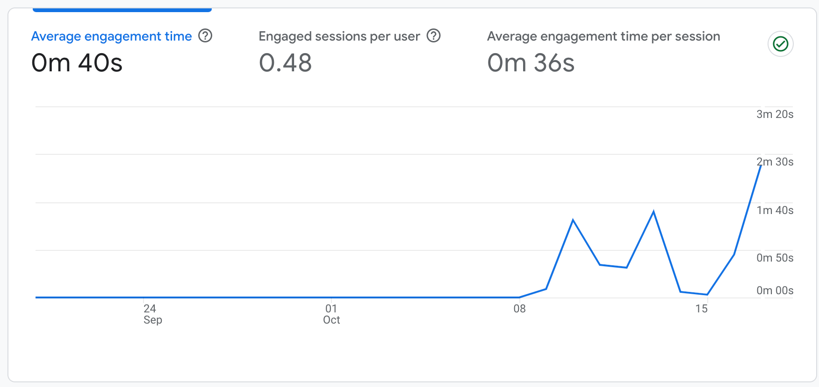

Slide 57
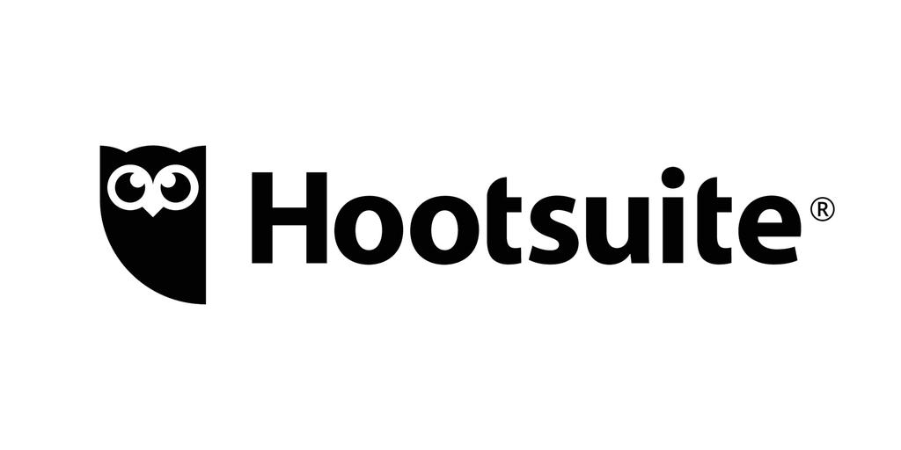
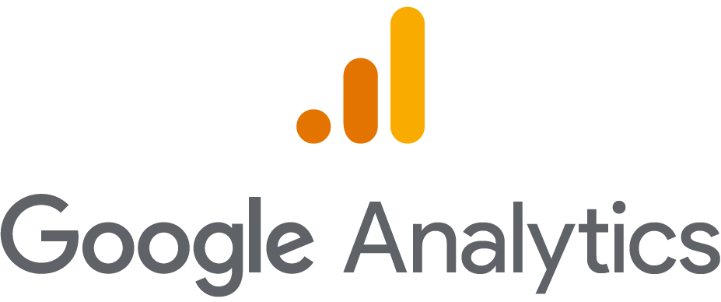
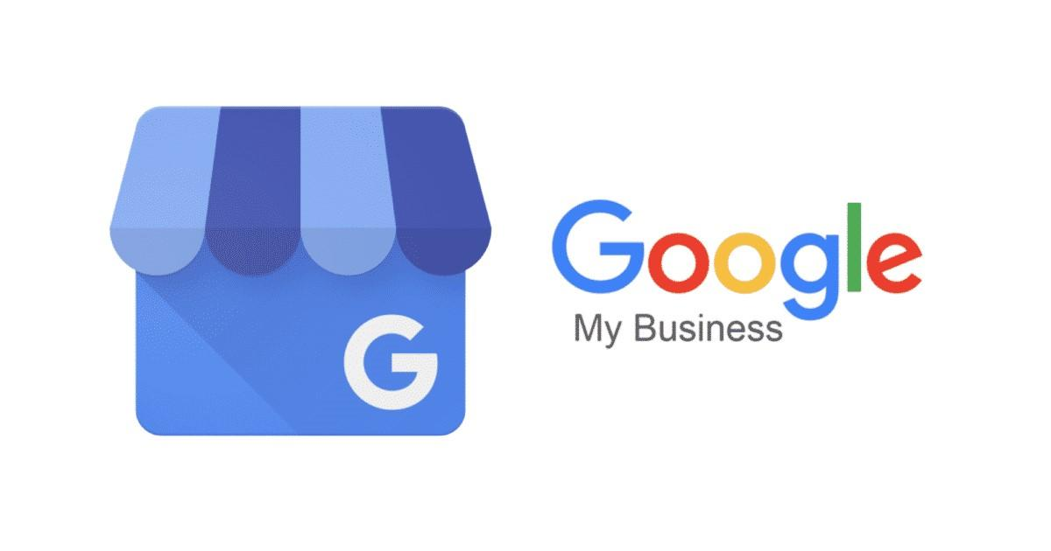
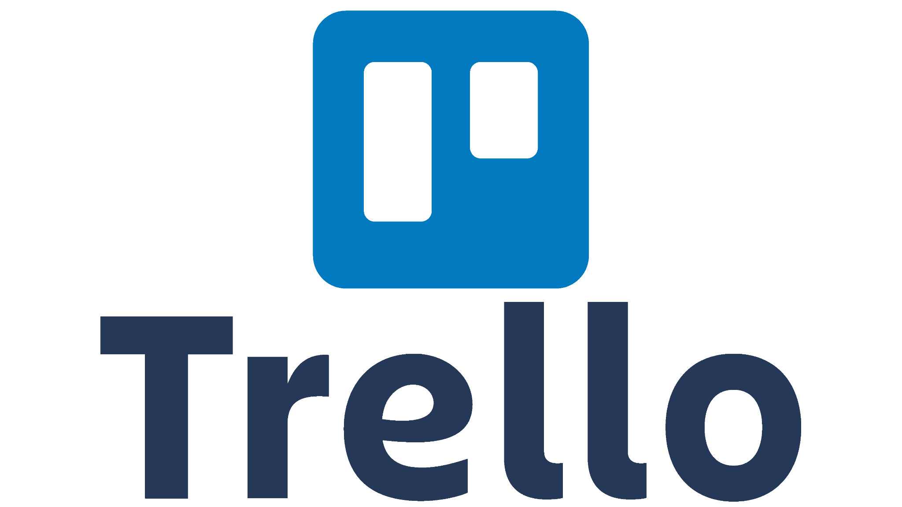
Recommended Tools

Slide 58
Google Analytics: Understand your website's performance and user behavior. It's free and provides valuable insights.
Google Search Console: Monitor how your site appears in Google's search results and identify opportunities for SEO improvement.
Mailchimp: A free or low-cost email marketing platform that's great for sending newsletters and automated email campaigns.
Canva: Create professional-looking graphics and visual content for social media, blog posts, and more, with both free and paid options.
Hootsuite: Schedule and manage social media posts across multiple platforms. The free version allows you to manage up to three social profiles.
Trello: Organize marketing campaigns and projects with this free project management tool.
Google Keyword Planner: Research keywords for SEO and pay-per-click (PPC) advertising. It's part of Google Ads and free to use.
SurveyMonkey: Create surveys and gather customer feedback. There's a free version with basic features.
Sumo: A suite of marketing tools including pop-ups, social sharing, and email capture. Offers free and paid plans.
KeywordTool.io: Find long-tail keywords and content ideas for your blog or website. It has both free and paid versions.
Google My Business: Claim and optimize your Google business listing to improve your local search presence. It's free.
Notes:
If you have a shopify site, shopify forms and emails is FREE

Slide 59
Test, Evolve, and Be OK With Failure
1. Embrace Change
2. Continuous Learning
3. Customer Feedback
4. Data-Driven Decisions
5. Agility and Flexibility
Notes:
You’ll eventually learn the right levers to pull to reach the right people.
Recognize that change is inevitable and often brings new possibilities. Be open to trying new approaches and technologies.
Stay informed about industry trends, emerging technologies, and evolving consumer behaviors. Invest in learning and skill development.
Watch your competitors
Listen to your customers. Their feedback can provide valuable insights for improvements and adaptations to your products, services, and marketing strategies. Set up feedback systems.
Base your marketing decisions on data and analytics. Regularly review performance metrics to identify areas that need adjustment.
Build a marketing strategy that allows for flexibility and quick responses to changing market conditions or unexpected events.

Slide 60
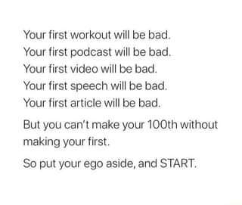
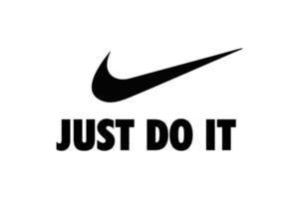
Key Takeaways
Notes:
I want to leave you with one of my favorite quotes I’ve seen all over social media. This was posted by Barbara Corcoran. I can’t find the original source.
Marketing is a lot of failure and a little success. So go out and just do it. Iterate and test and you’ll get better over time.

Slide 61
Questions

Slide 62
Connect With Me!
https://dot.cards/qlinemedia

